Slide 1


Data Analytics for understanding career aspirations Gen Z
Nikhil Lonkar

Slide 2
ROADMAP
1
3
5
9
Data Collection
7
Dashboards
Exploratory Data Analysis (EDA)
General Excel Dashboard KPIs:
Presentation
Developed three Excel dashboards focused on customer service, finance, and orders.
Created a Google Form with tailored questions to collect data on Gen-Z's career aspirations.
Total participants, total pin codes, with gender slicer. Visuals: Pivot charts highlighting preferences and trends..
Used Excel pivots to explore Gen Z’s career interests, work preferences, and key decision factors.
Worked on an employer-focused project, delivering recommendations and highlighting data storytelling.
2
4
6
8
Problem Statement
Data Cleaning & Preparation
Functional Dashboards in Power BI
Data Analysis in SQL
Developed a problem statement to Explored Gen-Z career aspirations to address gaps with employer expectations and share key insights
Standardized data columns, handled nulls, and prepared the final dataset for analysis in Excel, SQL, and Power BI.
Ran SQL queries to answer business questions and extract insights from collected data.
Built Power BI dashboards highlighting Gen Z’s aspirations, employer needs, and key KPIs.

Slide 3
STAGE 1: EXCEL DASHBOARDS

Slide 4
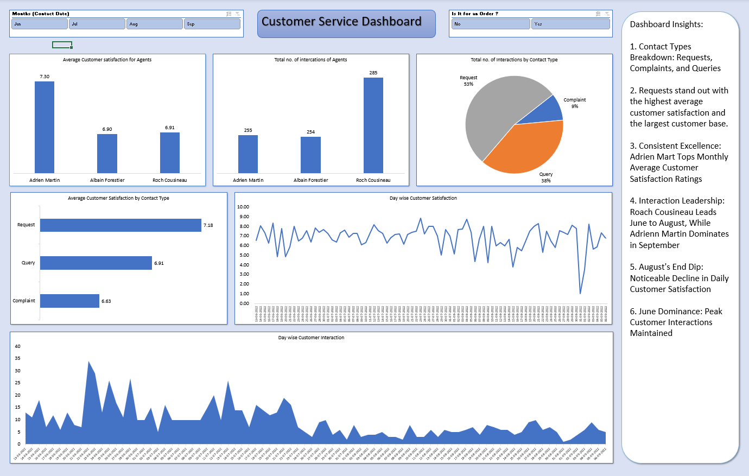

Slide 5
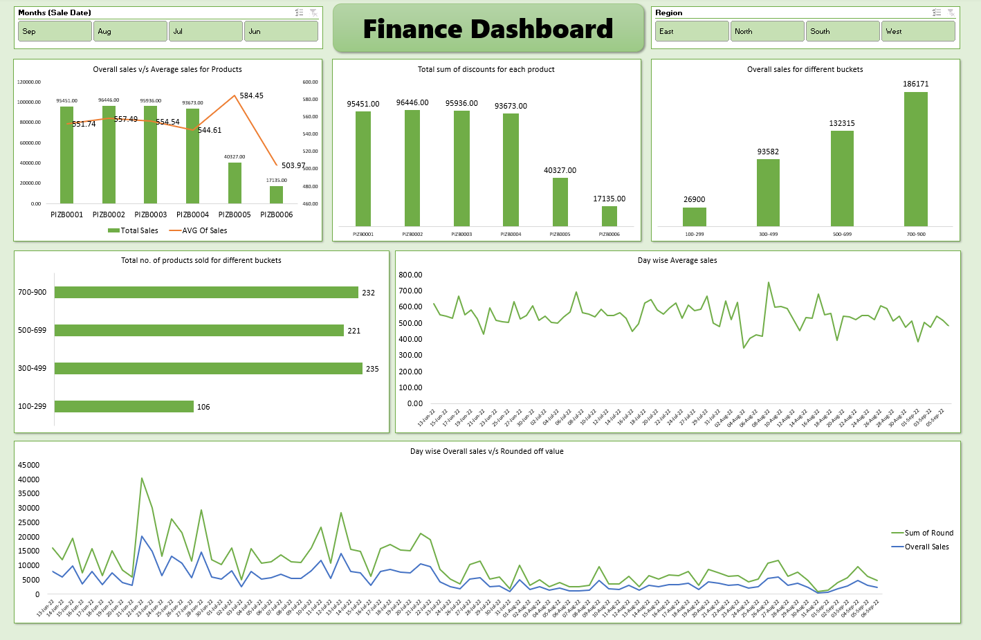

Slide 6
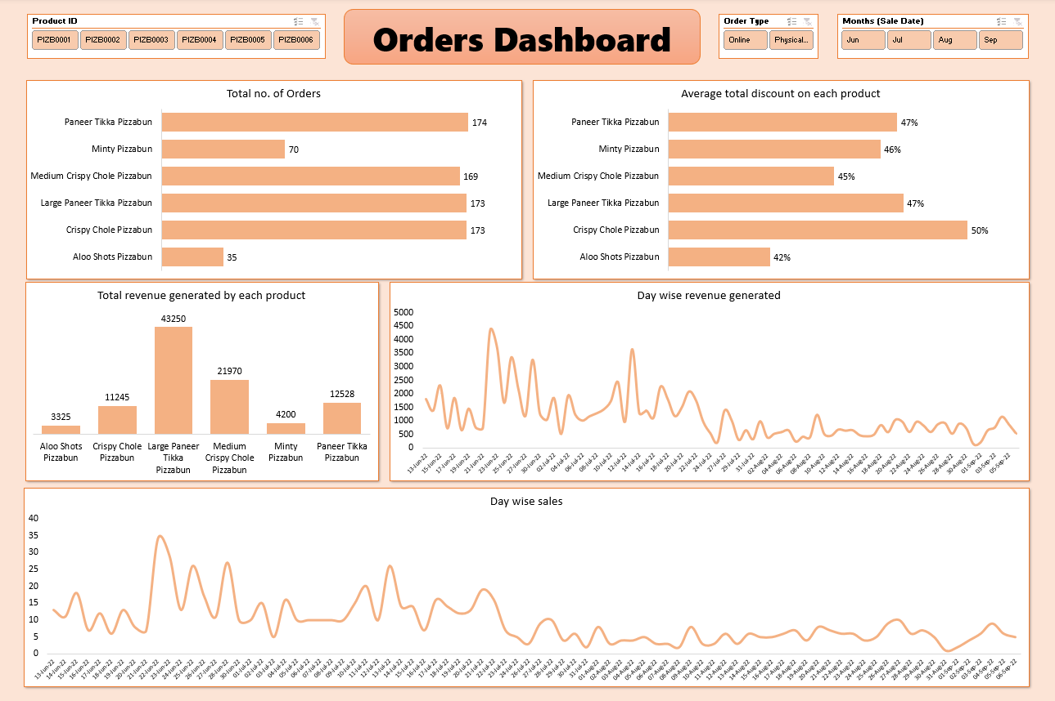

Slide 7
STAGE 2: PROBLEM STATEMENT

Slide 8
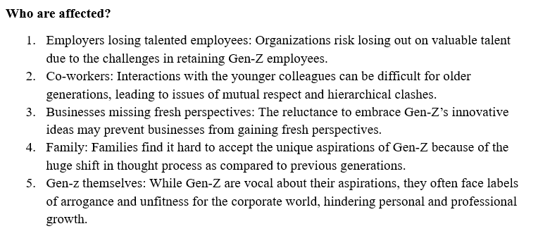
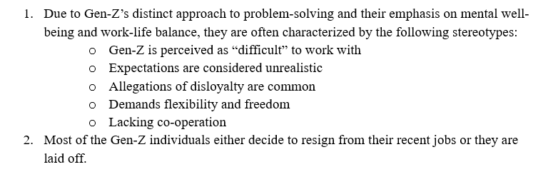
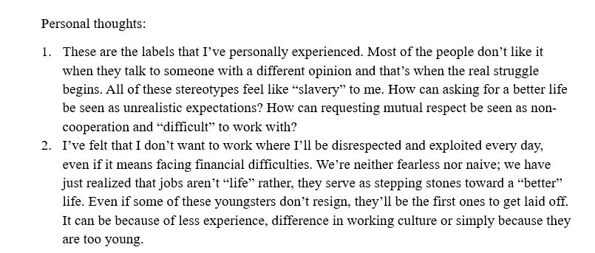
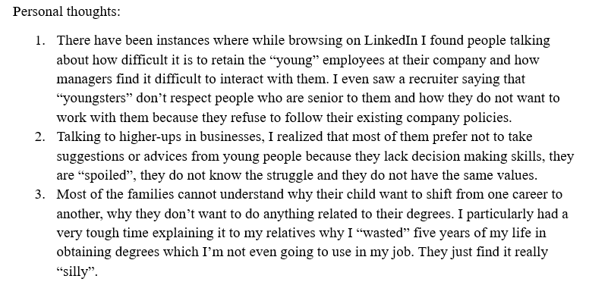
Who is affected?
What is happening?

Slide 9
Who is affected?
What is happening?
Employers losing talented employees: Organizations risk losing valuable talent due to challenges in retaining Gen-Z employees.
Co-workers: Older generations may struggle to interact with Gen-Z, leading to issues of respect and hierarchical clashes.
Businesses missing fresh perspectives: Businesses may miss innovative ideas if they’re reluctant to embrace Gen-Z’s perspectives.
Family: Families often struggle to accept Gen-Z’s unique aspirations, which differ greatly from previous generations.
Gen Z themselves: Despite being vocal about aspirations, Gen-Z often face labels of arrogance or being unfit for the corporate world, hindering growth.
Personal Thoughts:
On LinkedIn, I’ve read people complaining about retaining “young” employees and how managers find it hard to interact with them.
Higher-ups often dismiss young people’s suggestions, believing they lack decision-making skills.
Many families don’t understand why Gen-Z wants to shift careers or not use their degrees. I personally struggled to explain why I “wasted” five years earning degrees I’m not using in my job. My relatives thought it was “silly.”
Due to Gen-Z’s unique approach emphasizing mental well-being and work-life balance, they often receive labels like:
“Difficult” to work with
Unrealistic expectations
Disloyalty
Demanding flexibility and freedom
Lacking cooperation
Many Gen-Z employees either resign from jobs or get laid off due to misalignment with work cultures.
Personal Thoughts:
I’ve experienced these stereotypes. People dislike hearing different opinions, and that’s when struggles begin. To me, these stereotypes feel like “slavery.” Asking for a better life shouldn’t be seen as unrealistic.
I’d rather leave a job than stay in an environment where I’m disrespected and exploited—even if that means financial difficulties. Jobs are stepping stones to a better life, not life itself. Even if we don’t resign, we’re often first to be laid off because of inexperience or cultural differences.

Slide 10
When is this happening?
Why is this happening?
It’s hard to pinpoint exact timing, but a significant portion of Gen-Z entered the workforce during or after the pandemic, making engagement challenges more pronounced during this period.
Personal Thoughts:
Many friends started working during the pandemic—a time of massive uncertainty. The unstable job market has deeply impacted our plans for the future.
Employers: Struggle to align with Gen-Z’s unique work style, making engagement difficult.
Communication gaps: Inter-generational communication issues hinder idea-sharing and growth.
Businesses: Gen-Z is often seen as disloyal and prone to frequent job changes, complicating retention efforts.
Families: Lack understanding of Gen-Z’s aspirations, leading to stress and frustration.
Gen-Z themselves: Feel powerless, forced to adapt at the cost of their own expectations for a better life, which leads to burnout and mental health issues.
Personal Thoughts:
In a webinar, I met someone who admitted not knowing how to align with Gen-Z, though he saw them as valuable assets.
Many older professionals on LinkedIn told me to “keep expectations low” and avoid demanding better work-life balance. I found this extremely frustrating—it stifles growth.
I saw posts calling Gen-Z “not loyal” and advising businesses not to cater to their demands because it might upset power dynamics.
During my master’s thesis, my supervisor took credit for my work. I did nothing because my degree depended on his signature. That powerless feeling was horrible, and many friends went through similar situations, silenced when asking for better conditions.
Where is this happening?
Engagement challenges exist globally and across various industries:
Traditional office settings – Gen-Z increasingly prefers hybrid or flexible work.
Remote work models – Digital collaboration tools are crucial.
Hybrid work structures – Companies must balance in-office and remote needs.
Personal Thoughts:
On LinkedIn, I see frequent posts labeling our generation as unskilled or demanding. It’s discouraging and makes us feel like we constantly need a “reality check” from older professionals.

Slide 11
Personal Thoughts on Factors Contributing to Gen-Z’s Shift in Mindset
References
End of Generational Trauma: Millennials identified trauma; Gen-Z is determined to break free from it. I experienced this firsthand, overcoming challenges at home.
Mental Health Awareness: More people view mental health professionals as helpers, not just for “mad” people.
Pandemic Impact: Forced remote learning and personal loss made us question spending life in unfulfilling jobs.
Amplified Voices on Social Media: We want independence without corporate “enslavement.”
Economic Conditions: Recessions reveal how employers can be disloyal too. Loyalty should go both ways.
Rising Living Costs: Salaries haven’t kept pace, and many freshers are expected to work for minimal or no pay. Companies offering Rs 10,000/month for full-time work baffles me.
Self-Help Resources: Books like The Things You Can See Only When You Slow Down and Imperfect by Haemin Sunim changed my outlook on life.
Authentically Gen Z: The Values, Aspirations & Drivers That Will Re-Define the Future of Work
Gen Z: The workers who want it all
Sentiments of Indian Gen Z workforce in 2023: Part I
Gen-Z Is Labeled As ‘Difficult’ In The Workplace, But There’s More To The Story
How does Gen Z see its place in the working world? With trepidation
Why Gen Z workers are already so burned out
Aspirations & Wants of Generation Z - A Study on the Work Force of the Future

Slide 12
STAGE 3: DATA COLLECTION

Slide 13
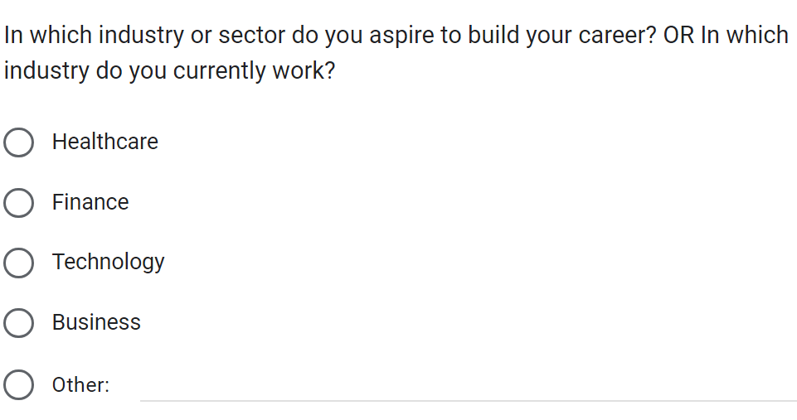
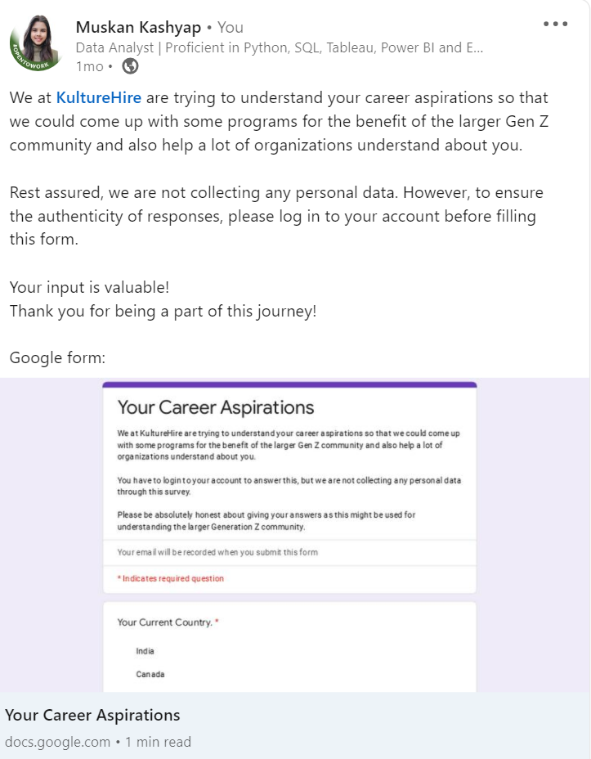
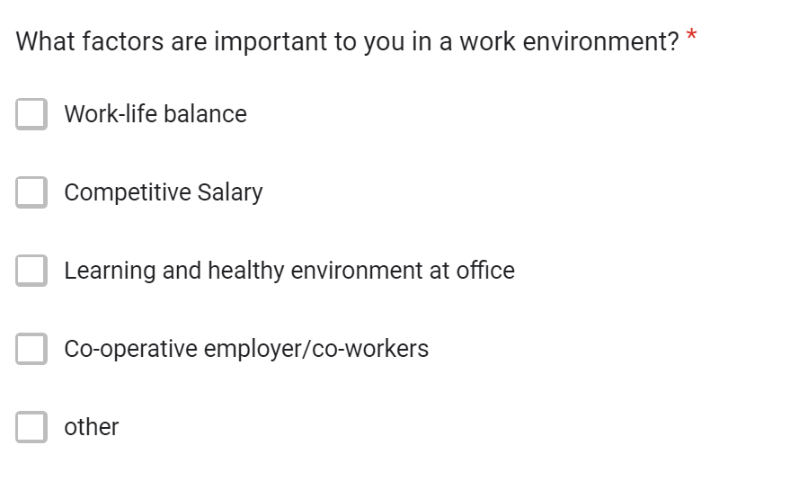
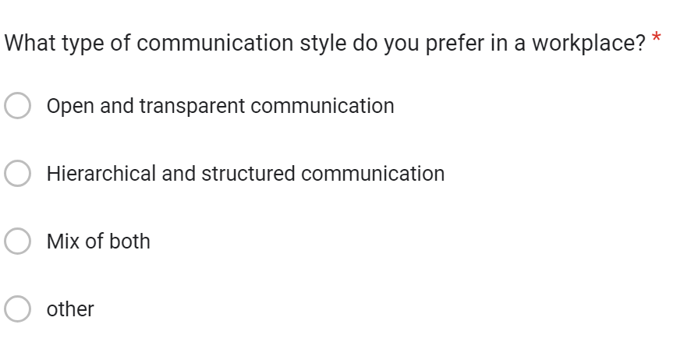

Slide 14
STAGE 4: Data Cleaning & Preparation

Slide 15
My Data Cleaning Process:
Renamed column headers for clarity
Converted null values to zeros
Standardized similar text entries
Removed extra spaces
Sorted data for better readability
Ensured consistent data formats

Slide 16
STAGE 5: Exploratory Data Analysis (EDA)

Slide 17
Exploratory Data Analysis Summary
✅ Top Career Interests: Creative Design, Data Analysis, Technology ✅ Key Career Drivers: Family influence, visionary goals, personal values ✅ Preferred Work Style: Hybrid > Remote > In-office ✅ Financial Goals: Most aim for ₹31K-₹40K initially, higher growth expected in 5 years ✅ Social Impact: Strong preference for purpose-driven companies
🔎 Insight: Gen Z seek meaningful work, flexibility, and clear financial progression

Slide 18
STAGE 6: Data Analysis in SQL

Slide 19
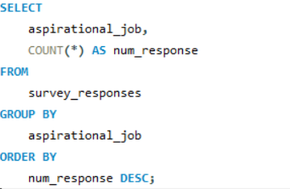
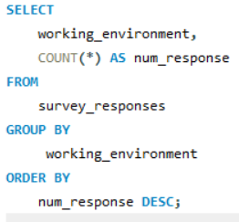
Gen-Z Career Insights: Findings from MySQL Data Analysis
1. What industries are Gen-Z most interested in pursuing careers in?
2. What are the top factors influencing Gen-Z’s career choices?

Slide 20
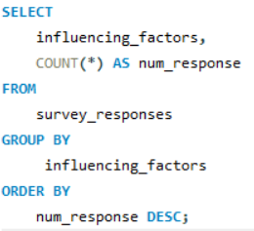
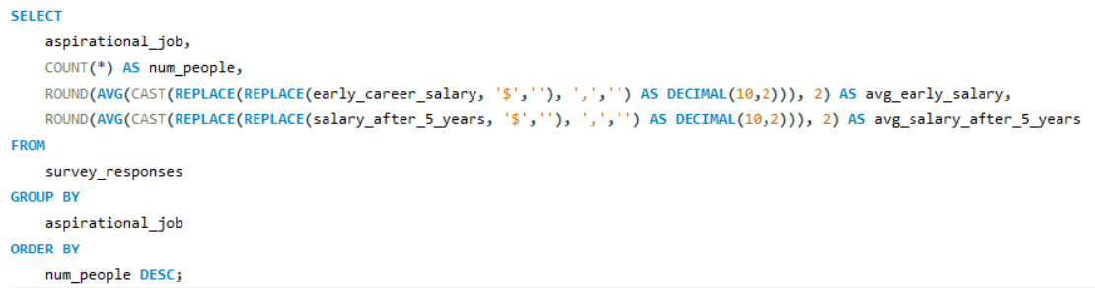
3. What is the desired work environment for Gen-Z?
4. How do financial goals, such as salary and benefits, impact career aspirations among Gen-Z?

Slide 21
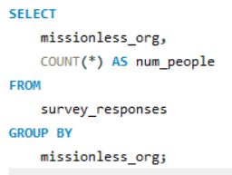
5. What role do personal values and social impact play in career choices for Gen-Z?

Slide 22
STAGE 7: General Excel Dashboard

Slide 23
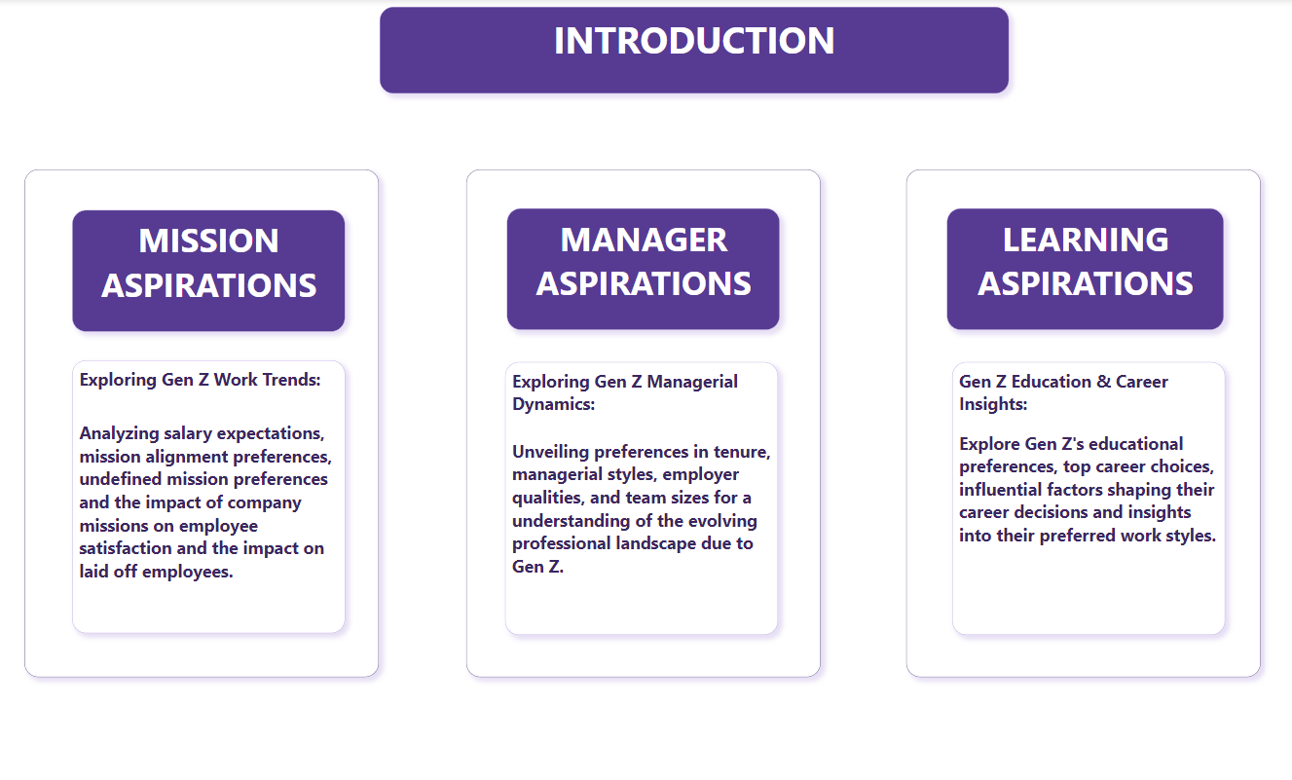

Slide 24
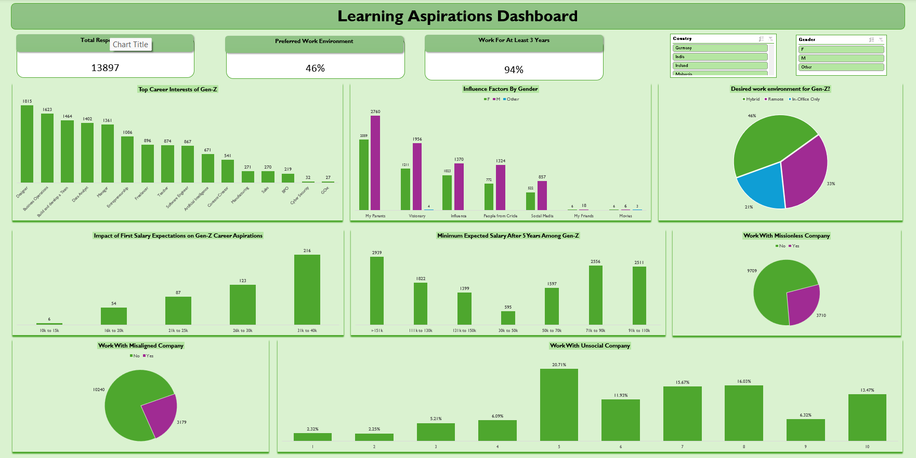

Slide 25
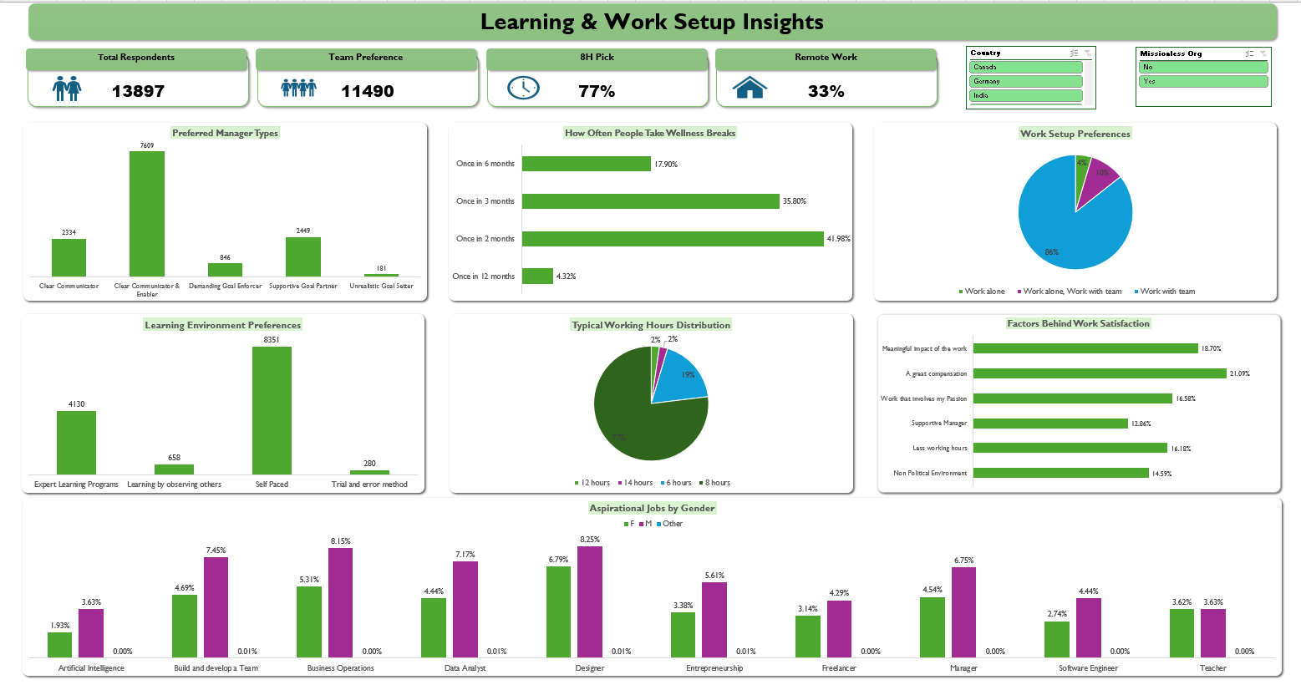

Slide 26
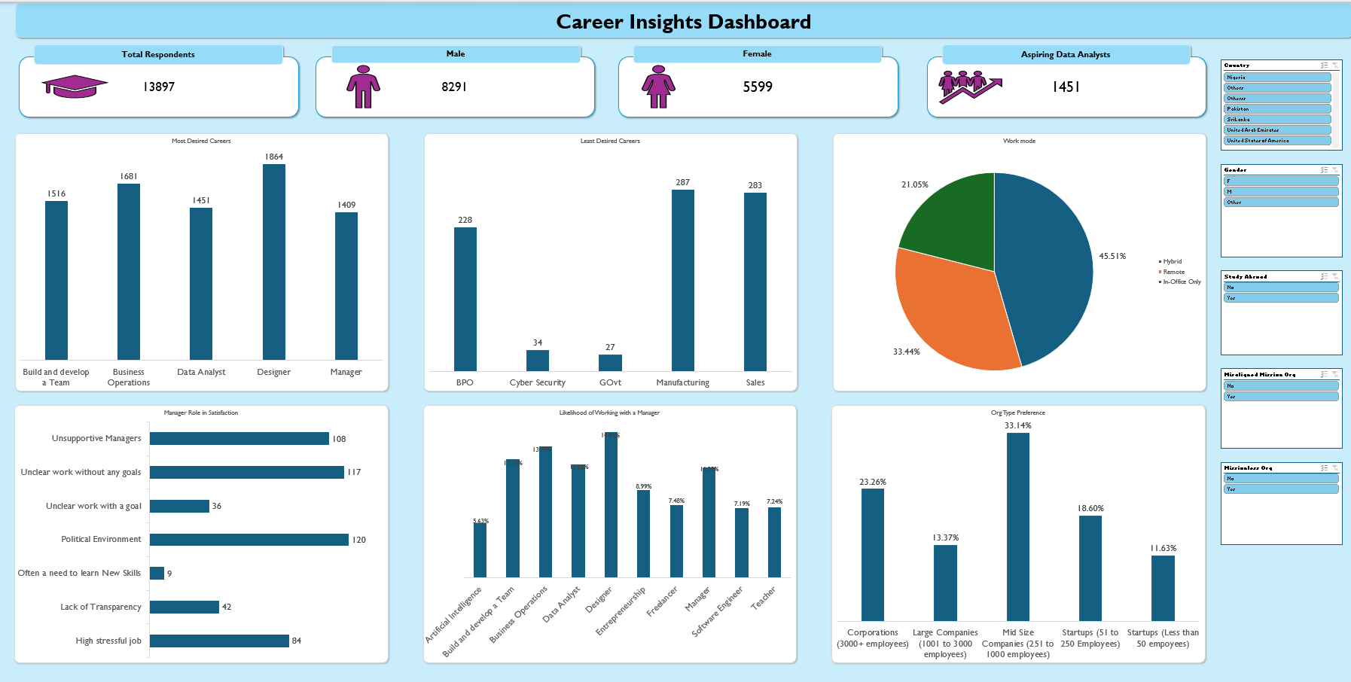

Slide 27
STAGE 8: Functional Dashboards in Power BI

Slide 28
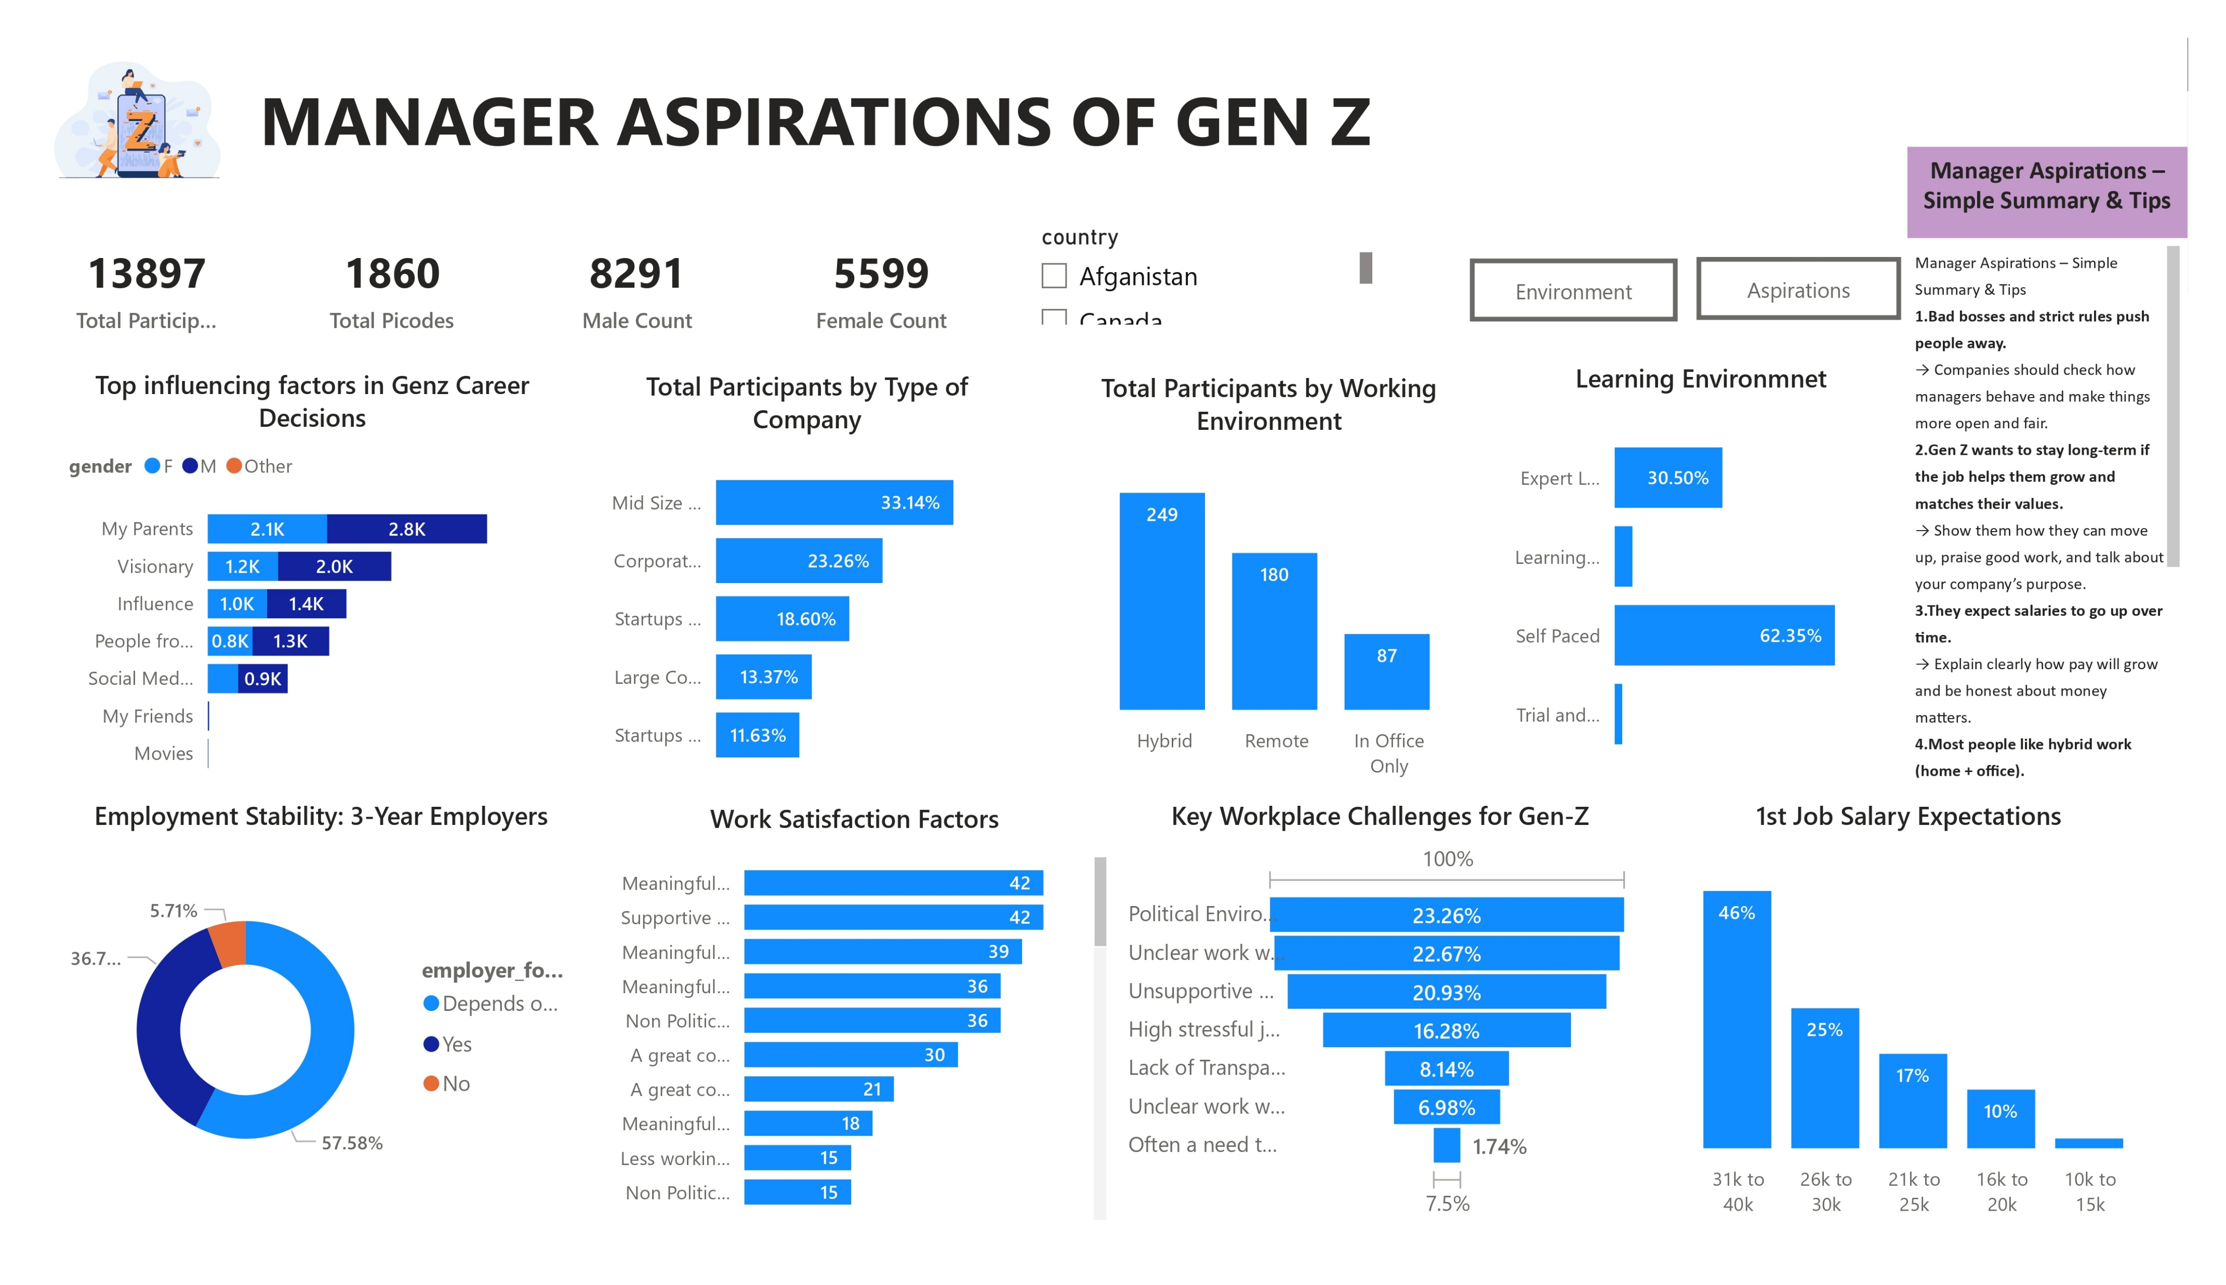

Slide 29
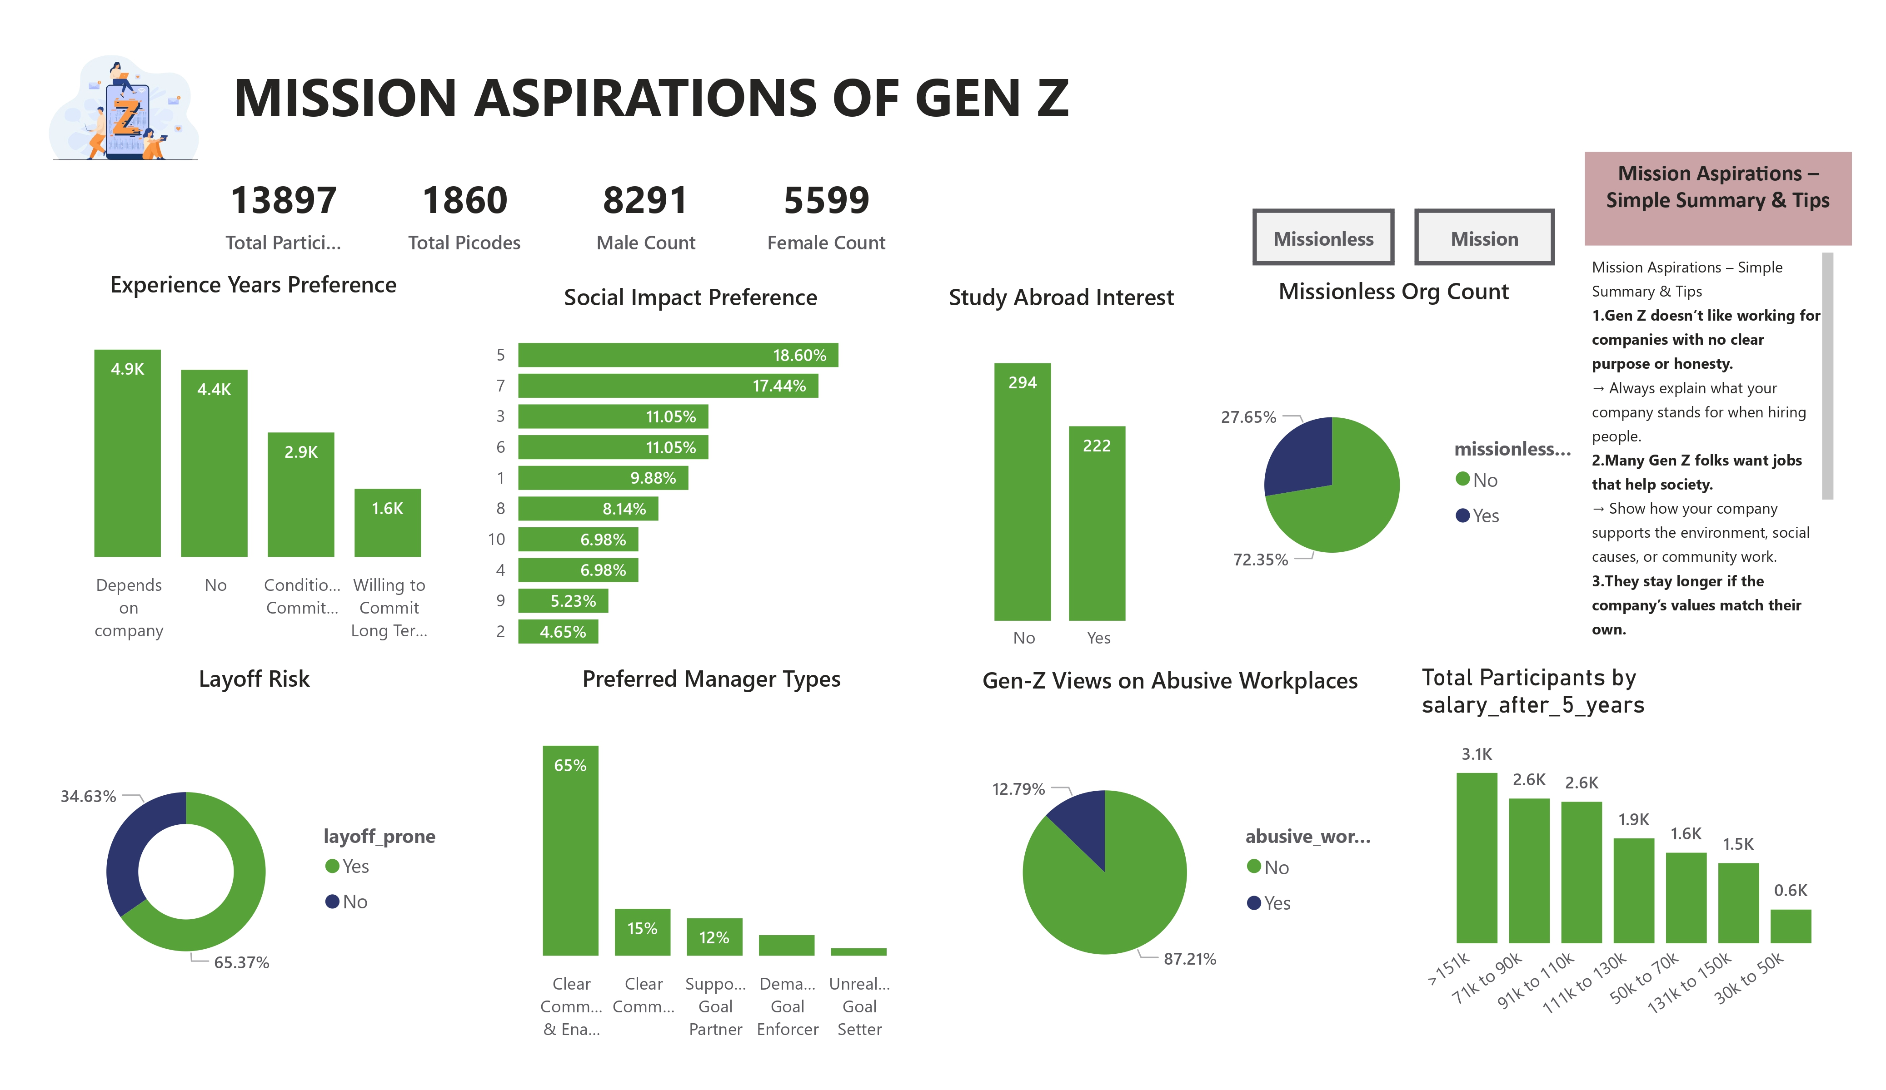

Slide 30
The Walt Disney Company
Disney operates a vast array of businesses, including film studios, television networks, theme parks, and resorts.
Some of its notable divisions and subsidiaries include Walt Disney Studios, Disney Media Networks, Disney Parks, Experiences and Products, and Disney Direct-to-Consumer & International.
The company is renowned for its contributions to the entertainment industry, particularly through the creation of iconic animated characters and films.
Disney's theme parks, including Disneyland and Walt Disney World, are also famous worldwide.
How Disney uses data?
Shorter waiting times: By knowing where people are and what they like, Disney predict crowds and keep lines moving smoothly.
Personalized experiences: Ever feel like Disney knows you better than you know yourself? They suggest rides you'll love, recommend restaurants based on your tastes, or even send birthday greetings in the park! This is all possible because of data!
By understanding what guests like and dislike, Disney continues to improve their parks, shows, and movies.

Slide 31
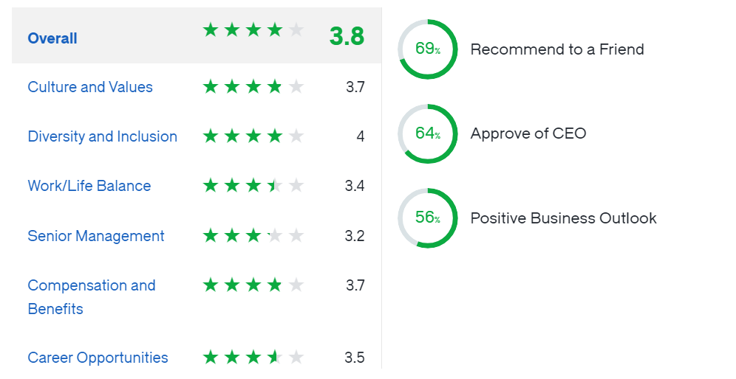
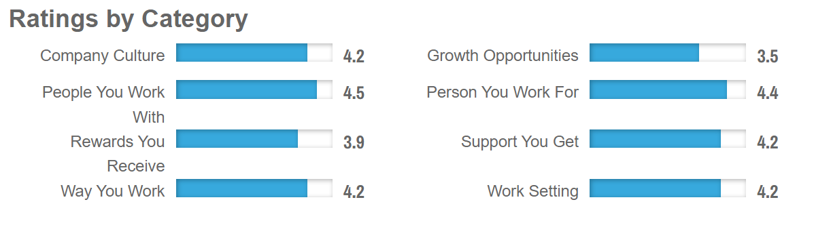
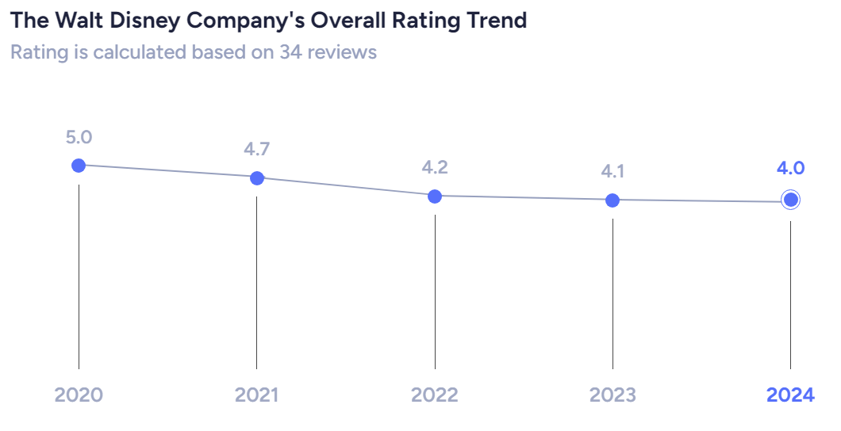
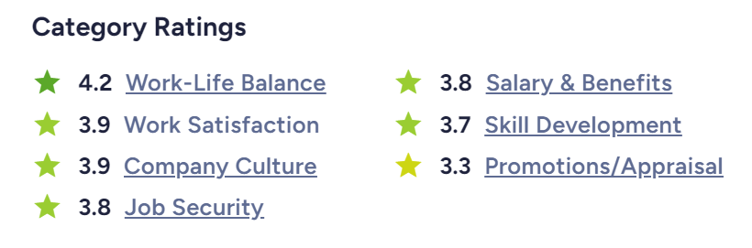
GLASSDOOR
CAREERBLISS
AMBITIONBOX
AMBITIONBOX

Slide 32
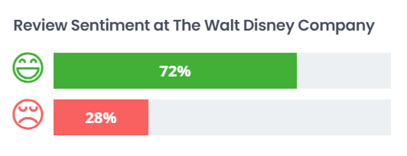
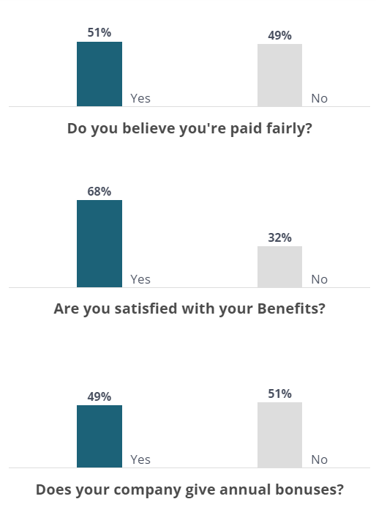
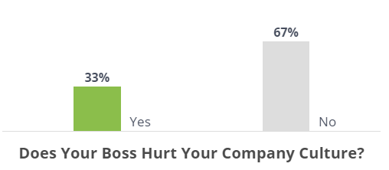
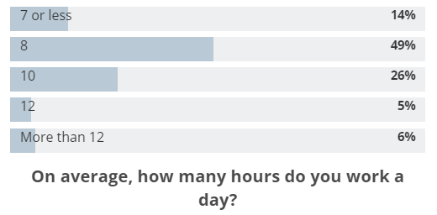
COMPARABLY
COMPARABLY
COMPARABLY

Slide 33
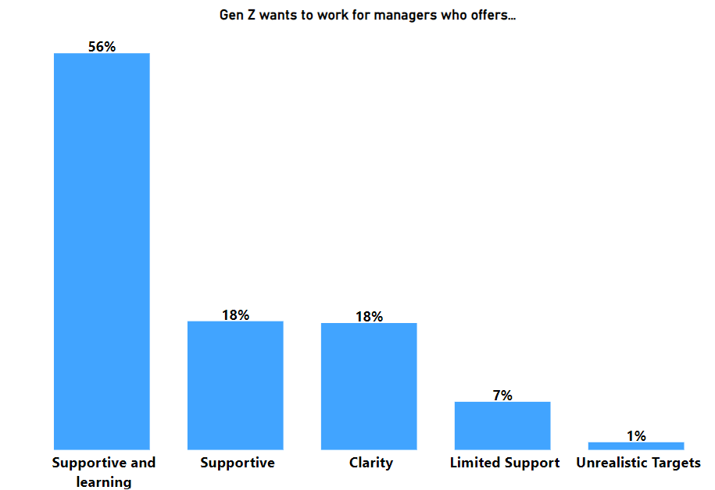
INSIGHTS
PROBLEM
Poor Managers or Leadership
RECOMMENDATIONS
Invest in leadership development programs
Implement a feedback system
Schedule regular meetings with the managers and teams to ensure open communication

Slide 34
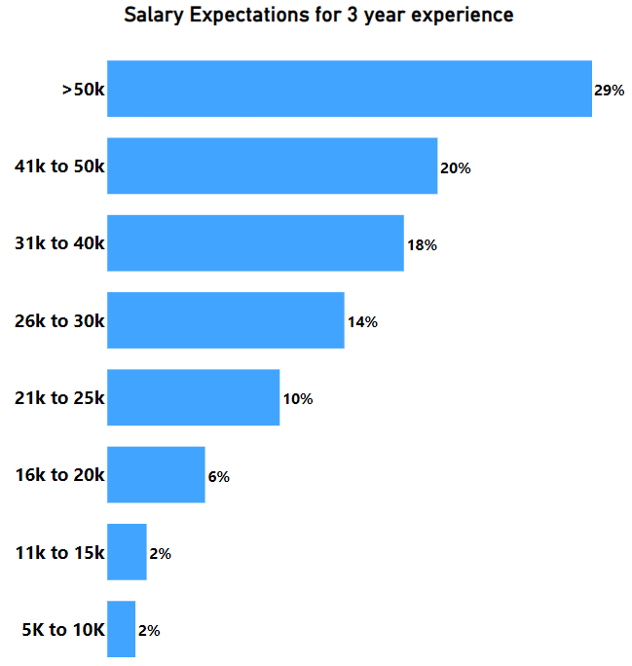
INSIGHTS
PROBLEM
Poor or Low Salaries
RECOMMENDATIONS
Conduct regular market research
Implement performance-based pay
Communicate openly about the company's financial situation
Enhance non-monetary benefits such as health insurance, flexible work hours or professional development opportunities

Slide 35
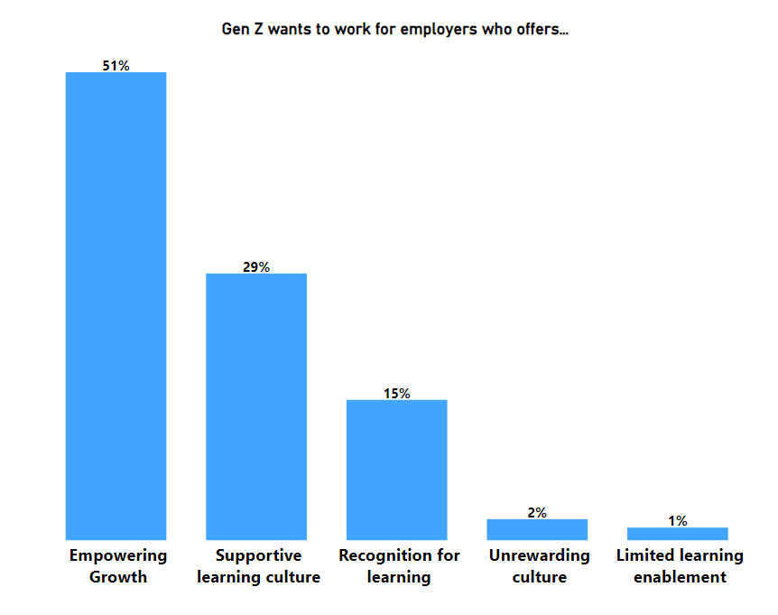
INSIGHTS
PROBLEM
Stagnant Growth
RECOMMENDATIONS
Create personalized career development plans
Provide constructive feedback
Establish clear criteria for promotions
Encourage cross-functional projects
Recognize and celebrate employees’ achievements

Slide 36
Thank You

